Slide 1
6.852: Distributed Algorithms Fall, 2015
Lecture 9

Slide 2
Today’s plan
Distributed commit
Formal modeling of asynchronous systems:
I/O automata
Executions and traces
Operations: composition, hiding
Properties and proof methods:
Invariants
Simulation relations
Reading: Section 7.3, Chapter 8
Next:
Asynchronous network algorithms: Leader election, breadth-first search, shortest paths, spanning trees.
Reading: Chapters 14 and 15
Notes:
A final problem of fault-tolerant consensus, in the synchronous network model.

Slide 3
Distributed Commit

Slide 4
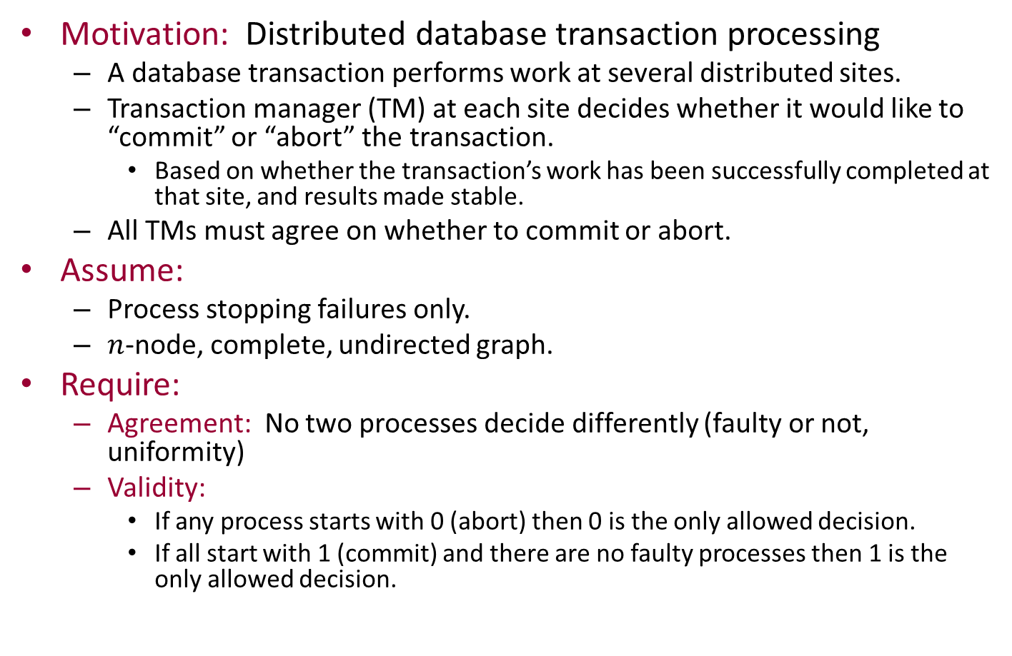
Distributed Commit
Motivation: Distributed database transaction processing
A database transaction performs work at several distributed sites.
Transaction manager (TM) at each site decides whether it would like to “commit” or “abort” the transaction.
Based on whether the transaction’s work has been successfully completed at that site, and results made stable.
All TMs must agree on whether to commit or abort.
Assume:
Process stopping failures only.
$n$-node, complete, undirected graph.
Require:
Agreement: No two processes decide differently (faulty or not, uniformity)
Validity:
If any process starts with 0 (abort) then 0 is the only allowed decision.
If all start with 1 (commit) and there are no faulty processes then 1 is the only allowed decision.
Notes:
Similar to one version of the 2-generals problem.

Slide 5
Correctness Conditions for Commit
Agreement: No two processes decide differently.
Validity:
If any process starts with 0 then 0 is the only allowed decision.
If all start with 1 and there are no faulty processes then 1 is the only allowed decision.
Note asymmetry: Guarantee abort (0) if anyone wants to abort; guarantee commit (1) if everyone wants to commit and no one fails (best case).
Termination:
Weak termination: If there are no failures then all processes eventually decide.
Strong termination (non-blocking condition): (Even if there are failures), all nonfaulty processes eventually decide.

Slide 6




2-Phase Commit
Traditional, blocking algorithm (guarantees weak termination only).
Assumes distinguished process 1, acts as “coordinator” (leader).
Round 1: All send initial values to process 1, who decides.
If it sees 0, or doesn’t hear from someone, it decides 0; otherwise it decides 1.
Round 2: Process 1 sends the decision to everyone else.
$$p_{1}$$
$$p_{2}$$
$$p_{3}$$
$$p_{4}$$
Q: When can the processes decide?
Anyone with initial value 0 can decide at the beginning.
Process 1 decides after receiving round 1 messages.
Everyone else decides after round 2 (if there are no failures).
Notes:
How can they decide after round 2?
If they hear the decision from the coordinator, they can just decide accordingly.
If not, then not clear what to do…

Slide 7
Correctness of 2-Phase Commit
Agreement:
Because decision is centralized (and consistent with any individual initial decisions).
Validity:
Because of how the coordinator decides.
Weak termination:
If no one fails, then everyone terminates by the end of round 2.
Strong termination?
No: If the coordinator fails before sending its round 2 messages, then others with initial value 1 will never terminate.

Slide 8
Add a termination protocol?
We might try to add a termination protocol: other processes try to detect failure of coordinator and finish agreeing on their own.
But this can’t always work:
If initial values are 0,1,1,1, then by validity, everyone is required to decide 0.
If initial values are 1,1,1,1 and process 1 fails just after deciding, and before sending out its round 2 messages, then:
Process 1 decides 1.
By agreement, others must decide 1.
But the other processes can’t distinguish these two situations.
0
1
1
1
1
1
1
1

Slide 9

Complexity of 2-phase commit
Time:
$2$ rounds
Communication:
At most $2n$ messages

Slide 10

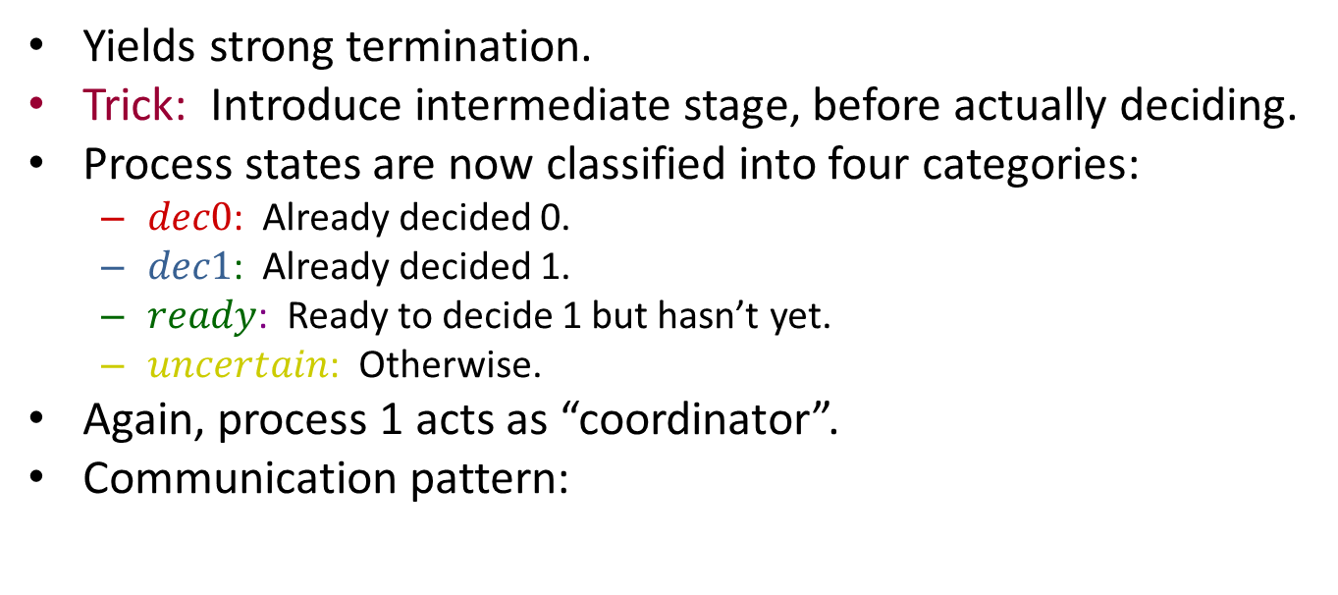
3-Phase Commit [Skeen]
Yields strong termination.
Trick: Introduce intermediate stage, before actually deciding.
Process states are now classified into four categories:
$dec0$: Already decided 0.
$dec1$: Already decided 1.
$ready$: Ready to decide 1 but hasn’t yet.
$uncertain$: Otherwise.
Again, process 1 acts as “coordinator”.
Communication pattern:
$$p_{1}$$

Slide 11
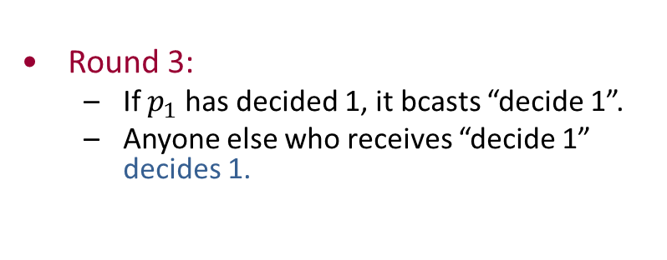
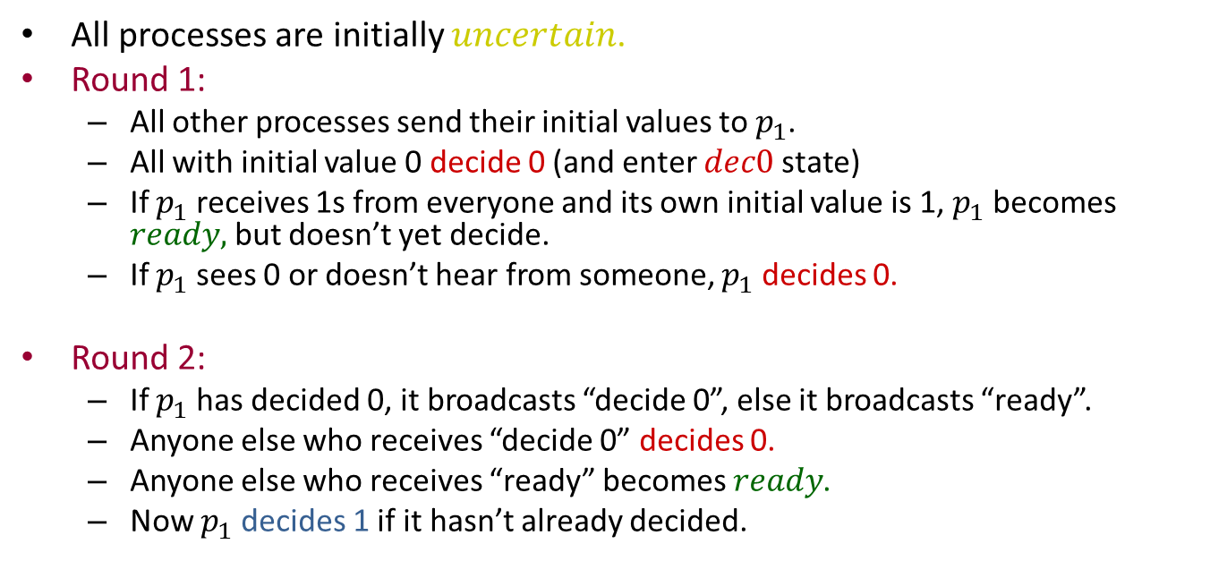
3-Phase Commit
All processes are initially $uncertain$.
Round 1:
All other processes send their initial values to $p_{1}$.
All with initial value 0 decide 0 (and enter $dec0$ state)
If $p_{1}$ receives 1s from everyone and its own initial value is 1, $p_{1}$ becomes $ready,$ but doesn’t yet decide.
If $p_{1}$ sees 0 or doesn’t hear from someone, $p_{1}$ decides 0.
Round 2:
If $p_{1}$ has decided 0, it broadcasts “decide 0”, else it broadcasts “ready”.
Anyone else who receives “decide 0” decides 0.
Anyone else who receives “ready” becomes $ready$.
Now $p_{1}$ decides 1 if it hasn’t already decided.
Round 3:
If $p_{1}$ has decided 1, it bcasts “decide 1”.
Anyone else who receives “decide 1” decides 1.

Slide 12
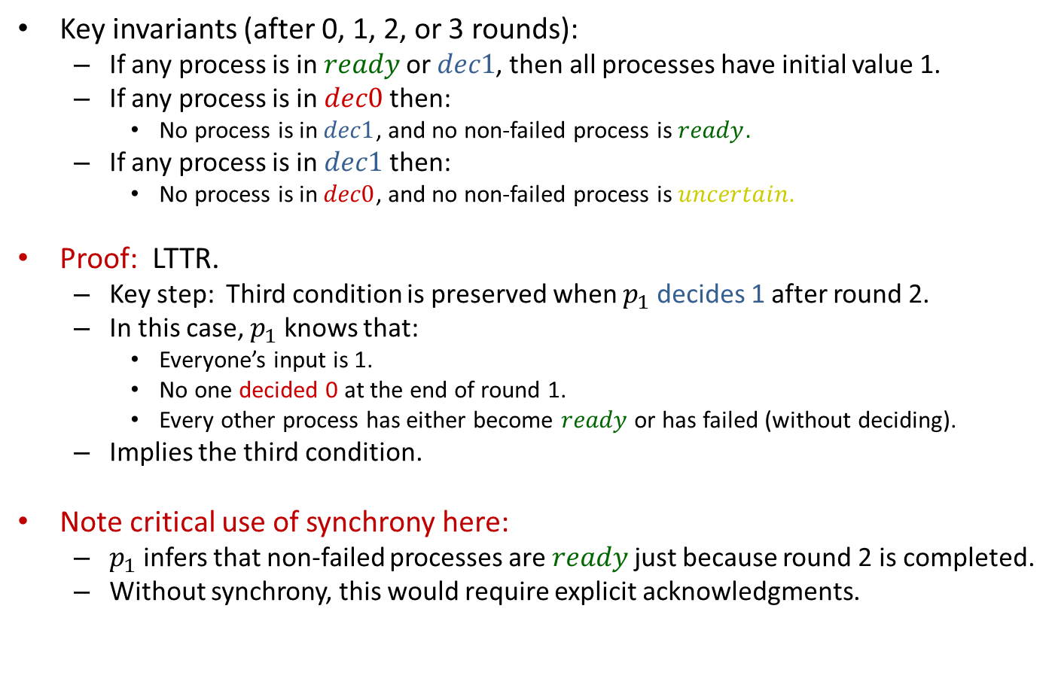
3-Phase Commit
Key invariants (after 0, 1, 2, or 3 rounds):
If any process is in $ready$ or $dec1$, then all processes have initial value 1.
If any process is in $dec0$ then:
No process is in $dec1$, and no non-failed process is $ready.$
If any process is in $dec1$ then:
No process is in $dec0$, and no non-failed process is $uncertain.$
Proof: LTTR.
Key step: Third condition is preserved when $p_{1}$ decides 1 after round 2.
In this case, $p_{1}$ knows that:
Everyone’s input is 1.
No one decided 0 at the end of round 1.
Every other process has either become $ready$ or has failed (without deciding).
Implies the third condition.
Note critical use of synchrony here:
$p_{1}$ infers that non-failed processes are $ready$ just because round 2 is completed.
Without synchrony, this would require explicit acknowledgments.
Notes:
Not yet a complete protocol, but let’s start showing some interesting properties.

Slide 13
Correctness conditions (so far)
Agreement and validity follow, for these three rounds.
Weak termination holds
Strong termination:
Doesn’t hold yet---must add a termination protocol.
Allow process 2 to act as coordinator, then 3,…
“Rotating coordinator” strategy
Notes:
Rotating coordinator strategy is used in other algorithms. E.g., in Dwork, Lynch, Stockmeyer paper, a precursor to Paxos.

Slide 14
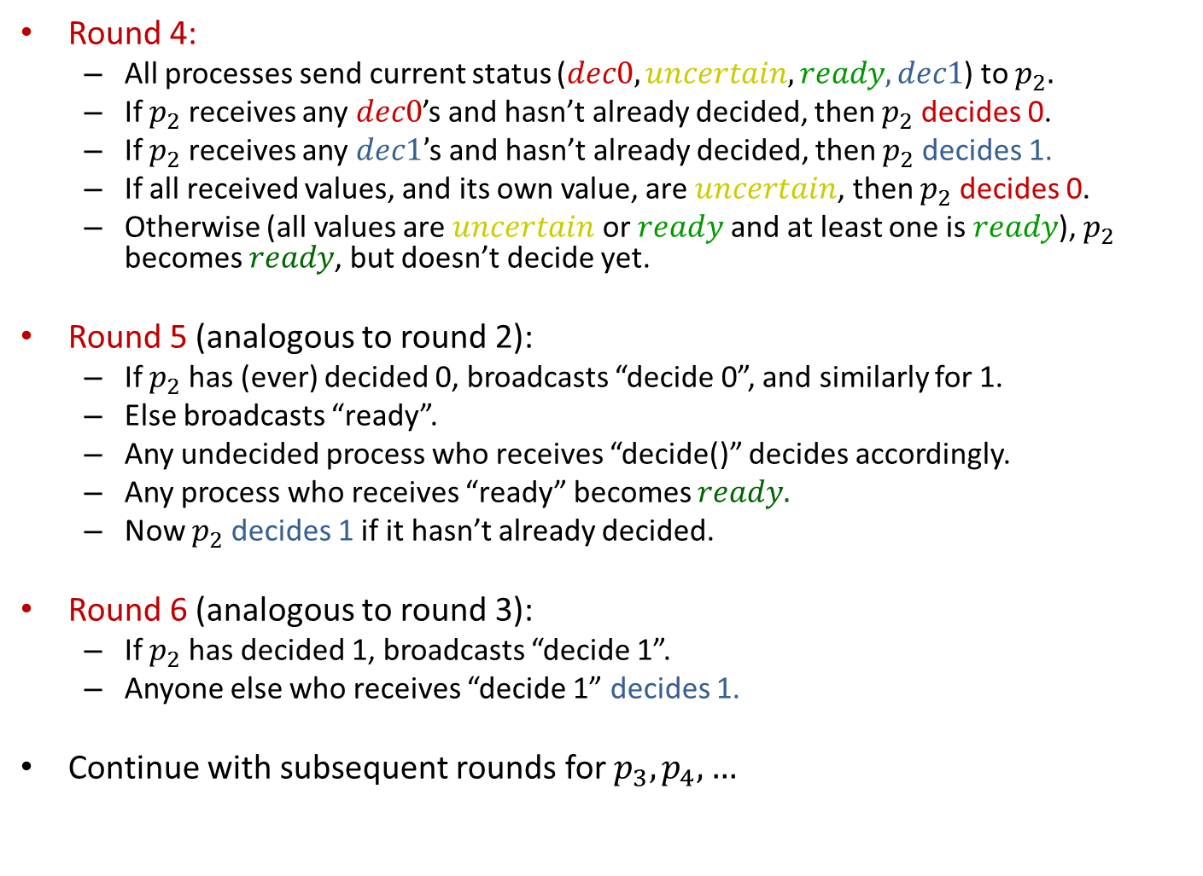
3-Phase Commit
Round 4:
All processes send current status ($dec0, uncertain, ready, dec1$) to $p_{2}.$
If $p_{2}$ receives any $dec0$’s and hasn’t already decided, then $p_{2}$ decides 0.
If $p_{2}$ receives any $dec1’$s and hasn’t already decided, then $p_{2}$ decides 1.
If all received values, and its own value, are $uncertain$, then $p_{2}$ decides 0.
Otherwise (all values are $uncertain$ or $ready$ and at least one is $ready$), $p_{2}$ becomes $ready$, but doesn’t decide yet.
Round 5 (analogous to round 2):
If $p_{2}$ has (ever) decided 0, broadcasts “decide 0”, and similarly for 1.
Else broadcasts “ready”.
Any undecided process who receives “decide()” decides accordingly.
Any process who receives “ready” becomes $ready.$
Now $p_{2}$ decides 1 if it hasn’t already decided.
Round 6 (analogous to round 3):
If $p_{2}$ has decided 1, broadcasts “decide 1”.
Anyone else who receives “decide 1” decides 1.
Continue with subsequent rounds for $p_{3},p_{4},…$

Slide 15
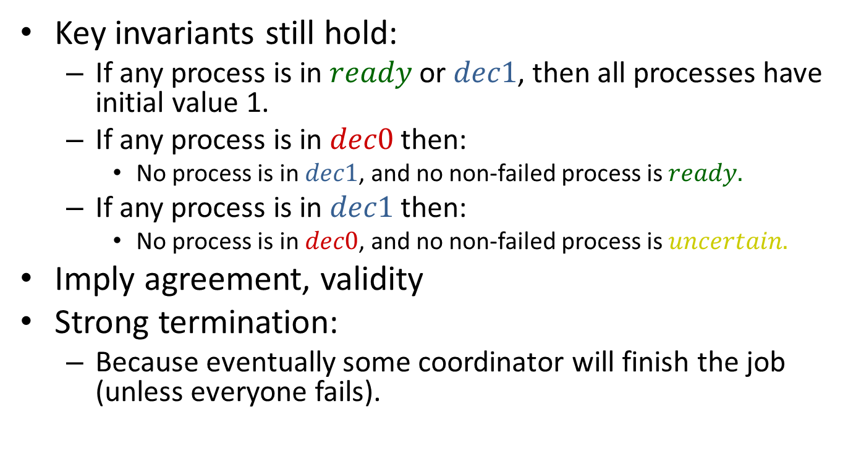
Correctness
Key invariants still hold:
If any process is in $ready$or $dec1$, then all processes have initial value 1.
If any process is in $dec0$ then:
No process is in $dec1$, and no non-failed process is $ready.$
If any process is in $dec1$ then:
No process is in $dec0$, and no non-failed process is $uncertain.$
Imply agreement, validity
Strong termination:
Because eventually some coordinator will finish the job (unless everyone fails).
Notes:
Actually these invariants imply just half of the validity condition---if anyone starts with 0 then 0 is the only possible decision. For the other direction, if everyone starts with 1 and there are no failures, then everyone finishes within 3 rounds with decision 1.

Slide 16
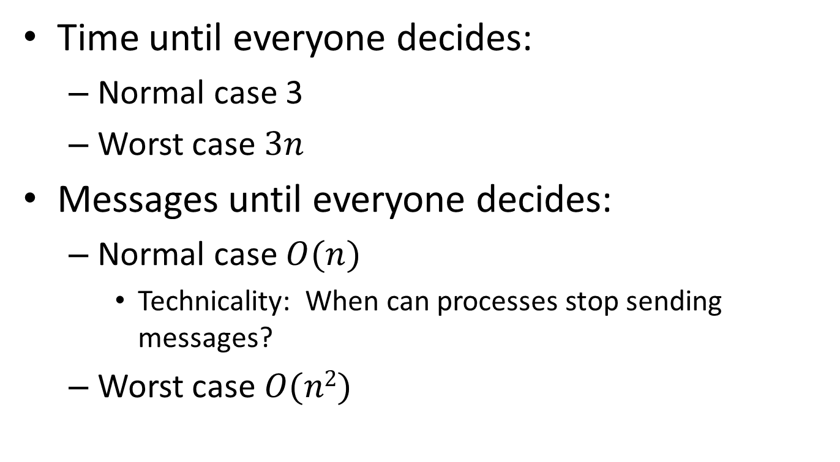
Complexity
Time until everyone decides:
Normal case 3
Worst case $3n$
Messages until everyone decides:
Normal case $O(n)$
Technicality: When can processes stop sending messages?
Worst case $O(n2)$
Notes:
We get a 3n message bound until everyone decides in the normal case, just 3 rounds.
But what if we wanted to bound the TOTAL number of messages in that case? We would need some protocol that allows processes to stop sending messages.
E.g., suppose someone, pi, gets a message at round 4 from p1. Then it knows that p1 succeeded in sending all its messages in round 3, so everyone decided by the end of round 3. Then pi could just halt, and stop sending messages.
Likewise, p1 could halt and stop sending messages after round 4, since it knows everyone who is still alive will get its round 4 messages.
But what if p1 dies in the middle of round 4? So some processes receive its message (and halt) and others don’t. Then the others would just continue the normal protocol, rotating coordinators. It’s just as if the halted processes failed. Since the rotation protocol yields uniform agreement in case they failed, it still works if they halt.
Likewise, a process could halt if it gets a message from p2 at round 7, etc.

Slide 17
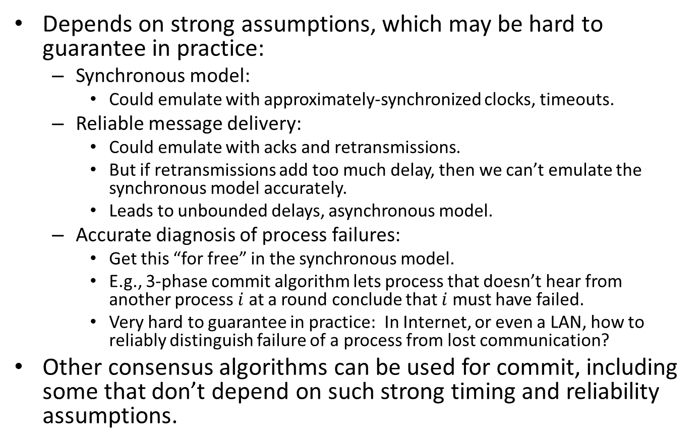
Practical issues for 3-phase commit
Depends on strong assumptions, which may be hard to guarantee in practice:
Synchronous model:
Could emulate with approximately-synchronized clocks, timeouts.
Reliable message delivery:
Could emulate with acks and retransmissions.
But if retransmissions add too much delay, then we can’t emulate the synchronous model accurately.
Leads to unbounded delays, asynchronous model.
Accurate diagnosis of process failures:
Get this “for free” in the synchronous model.
E.g., 3-phase commit algorithm lets process that doesn’t hear from another process $i$ at a round conclude that $i$must have failed.
Very hard to guarantee in practice: In Internet, or even a LAN, how to reliably distinguish failure of a process from lost communication?
Other consensus algorithms can be used for commit, including some that don’t depend on such strong timing and reliability assumptions.

Slide 18
Paxos consensus algorithm [Lamport]
A more robust consensus algorithm, can be used for commit.
Tolerates process stopping and recovery, message losses and delays,…
Runs in partially synchronous model.
Similar to algorithm by [Dwork, Lynch, Stockmeyer].
Algorithm idea:
Processes use an unreliable leader election subalgorithm to choose a coordinator, who tries to achieve consensus.
Coordinator decides based on active support from a majority of the processes.
Does not assume anything based on not receiving a message.
Subtleties arise when multiple coordinators are active---must ensure consistency.
Practical difficulties with fault-tolerance in the synchronous model motivate studying the asynchronous model (later today ).
Notes:
Will study this algorithm later in the course (asynchronous consensus).
I mean practical difficulties with implementing the fault-prone synchronous model on less well-behaved platforms.

Slide 19
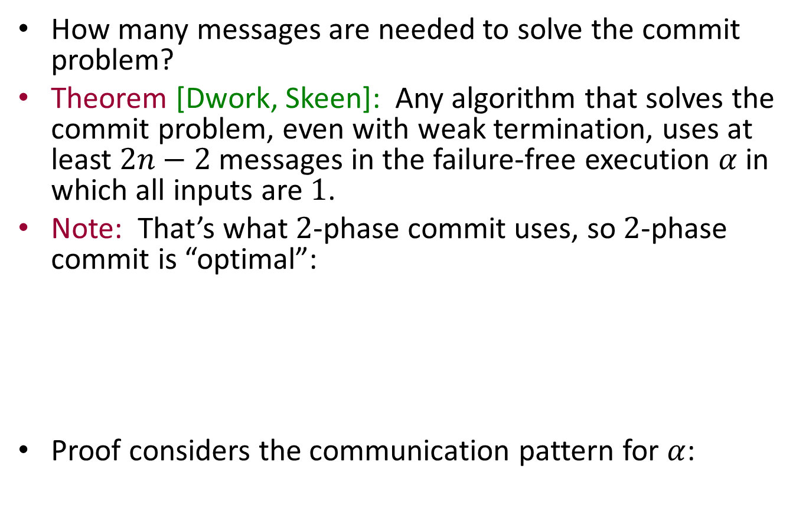




A Lower Bound for Commit
How many messages are needed to solve the commit problem?
Theorem [Dwork, Skeen]: Any algorithm that solves the commit problem, even with weak termination, uses at least $2n−2$messages in the failure-free execution $α$in which all inputs are $1$.
Note: That’s what $2$-phase commit uses, so $2$-phase commit is “optimal”:
Proof considers the communication pattern for $α$:
$$p_{1}$$
$$p_{2}$$
$$p_{3}$$
$$p_{4}$$
Notes:
Weak requirements.
A very particular execution, the best-case one.
The picture is just for the particular pattern used in 2-phase commit.

Slide 20

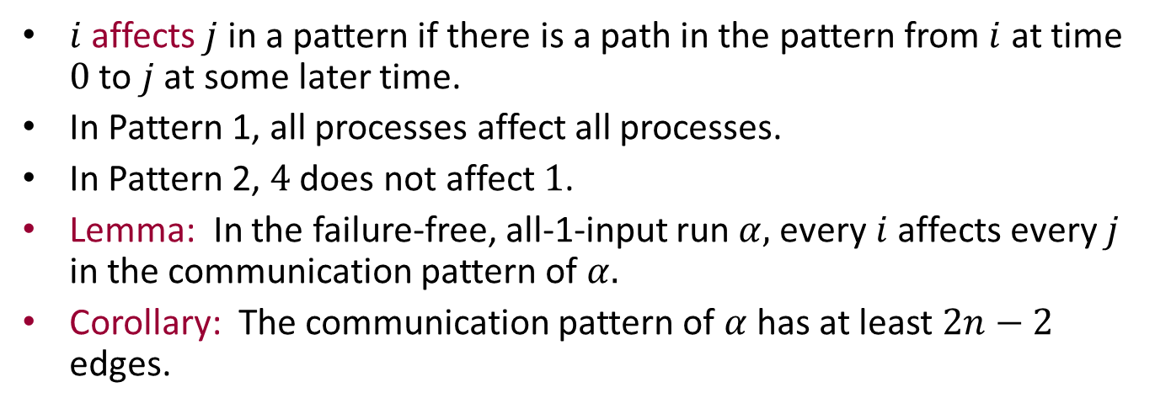







Information flow in a communication pattern
$$p_{1}$$
$$p_{1}$$
$$p_{2}$$
$$p_{2}$$
$$p_{3}$$
$$p_{3}$$
$$p_{4}$$
$$p_{4}$$
$i$ affects $j$ in a pattern if there is a path in the pattern from $i$ at time $0$ to $j$ at some later time.
In Pattern 1, all processes affect all processes.
In Pattern 2, $4$ does not affect $1$.
Lemma: In the failure-free, all-1-input run $α,$every $i$affects every $j$ in the communication pattern of $α.$
Corollary: The communication pattern of $α$has at least $2n−2$ edges.
Notes:
4 does not affect 1, but all other pairs do affect each other.
To prove the corollary, we need a calculation, given in the textbook.

Slide 21

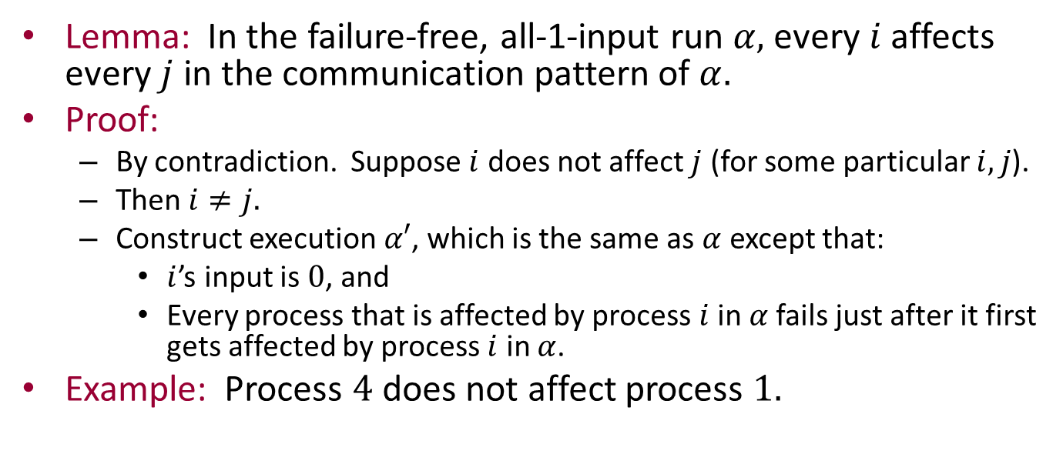







Proof of the Lemma
Lemma: In the failure-free, all-1-input run $α,$every $i$affects every $j$ in the communication pattern of $α.$
Proof:
By contradiction. Suppose $i$ does not affect $j$ (for some particular $i,j$).
Then $i≠j.$
Construct execution $α′$, which is the same as $α$ except that:
$i$’s input is $0$, and
Every process that is affected by process $i$ in $α$fails just after it first gets affected by process $i$ in $α$.
Example: Process $4$ does not affect process $1.$
$$p_{1}$$
$$p_{1}$$
1
1
1
$$p_{2}$$
1
$$p_{2}$$
$$p_{3}$$
$$p_{3}$$
1
1
1
$$p_{4}$$
0
$$p_{4}$$

Slide 22
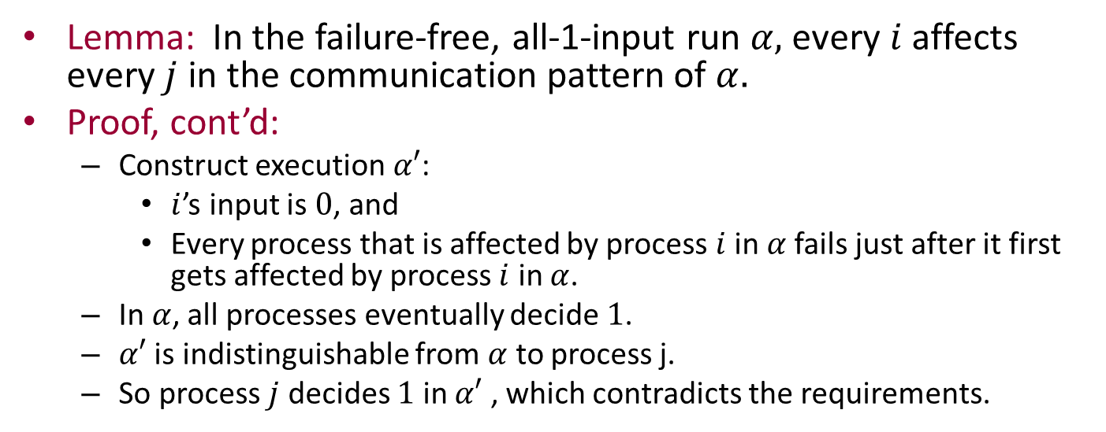
Proof of the Lemma
Lemma: In the failure-free, all-1-input run $α,$every $i$affects every $j$ in the communication pattern of $α.$
Proof, cont’d:
Construct execution $α′$:
$i$’s input is $0$, and
Every process that is affected by process $i$ in $α$fails just after it first gets affected by process $i$ in $α$.
In $α$, all processes eventually decide $1$.
$α′$ is indistinguishable from $α$ to process j.
So process $j$ decides $1$ in $α′$ , which contradicts the requirements.
$$p_{1}$$
$$p_{1}$$
1
1
1
$$p_{2}$$
1
$$p_{2}$$
$$p_{3}$$
$$p_{3}$$
1
1
1
$$p_{4}$$
0
$$p_{4}$$
Notes:
Why are the two indistinguishable to process j? This is not proved carefully in the book, or here. The idea is that, for j to tell the difference, there must have been some path over which some information could have travelled to j in alpha but not in alpha’. But all the edges we have removed have no path to j in alpha anyway.
Information flow arguments like these are still used in algorithms and lower bounds in modern algorithms, e.g., in Oshman’s thesis, which deals with computing functions in dynamically-changing networks.

Slide 23
Asynchronous Systems

Slide 24
Asynchronous systems
No timing assumptions
No rounds
Two kinds of asynchronous models:
Asynchronous networks
Processes communicating via channels
Asynchronous shared-memory systems
Processes communicating via shared objects
p₁
x₁
p₂
x₂
p_{n}
Notes:
We will switch the order in the book, consider asynchronous networks first. Closer to the synchronous network model we’ve been studying so far.
At first, no failure.
Then introduce failures for asynchronous shared memory, and then for networks.

Slide 25
Asynchronous network: Processes and channels
p₁
send(m)_{1,2}
C_{1,2}
receive(m)_{1,2}
p₂
init(v)₁
decide(v)₁
C_{2,1}
receive(m)_{2,1}
send(m)_{2,1}
Q: What are these ps and Cs?
A: “Reactive” components, which interact with their environments via input and output actions.

Slide 26
Asynchronous shared-memory system: Processes and objects
p₁
These processes and objects are also “reactive” components.
In both cases, we have reactive components.
We need a general model for reactive components.
x₁
p₂
x₂
p_{n}
x_{m}
Notes:
Processes that share objects.

Slide 27
Specifying problems and systems
Processes, channels, and objects are automata
Perform actions while changing state.
Reactive
Interact with environment via input and output actions.
Not just functions from input values to output values; they may have more kinds of interactions.
Execution:
Sequence of states and actions
Interleaving semantics
External behavior (trace):
We observe external actions.
States and internal actions are hidden.
Problems are defined in terms of allowable traces.
Notes:
We interleave what happens at different locations.

Slide 28
Input/Output Automata

Slide 29
Input/Output Automata
General mathematical modeling framework for reactive system components.
Little structure---must add special structure to specialize it for networks, shared-memory systems,…
Designed for describing systems in a modular way:
Supports description of individual system components, and how they compose to yield a larger system.
Supports description of systems at different levels of abstraction, e.g.:
Detailed implementation vs. higher-level algorithm description.
Optimized algorithm vs. simpler, un-optimized version.
Supports several standard proof techniques:
Invariants
Simulation relations (like running 2 algorithms side-by-side and relating their behavior step-by-step).
Compositional reasoning (prove properties of individual components; use compositional reasoning to infer properties for the overall system).
Notes:
We’ve seen the optimized vs. unoptimized breakdown before, for synchronous systems.

Slide 30
Input/Output Automaton
State transition system
Transitions labeled by actions
Actions classified as input, output, internal
Input, output are external.
Output, internal are locally controlled.

Slide 31
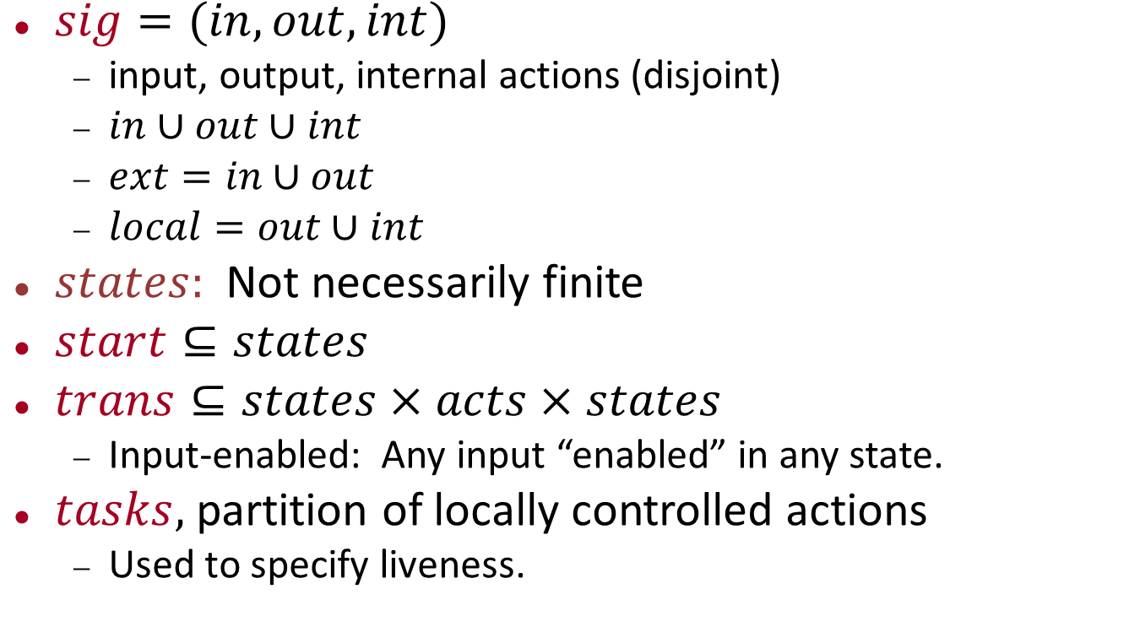
Input/Output Automaton, formally
$sig=(in,out,int)$
input, output, internal actions (disjoint)
$in∪out∪int$
$ext=in∪out$
$local=out∪int$
$states:$Not necessarily finite
$start⊆states$
$trans⊆states×acts×states$
Input-enabled: Any input “enabled” in any state.
$tasks,$ partition of locally controlled actions
Used to specify liveness.
Notes:
Start is a nonempty subset of states.
Task partition has only countably many equivalence classes.
Liveness: E.g., that something happens eventually, like an algorithm terminating.
We’ll come back to this later.

Slide 32
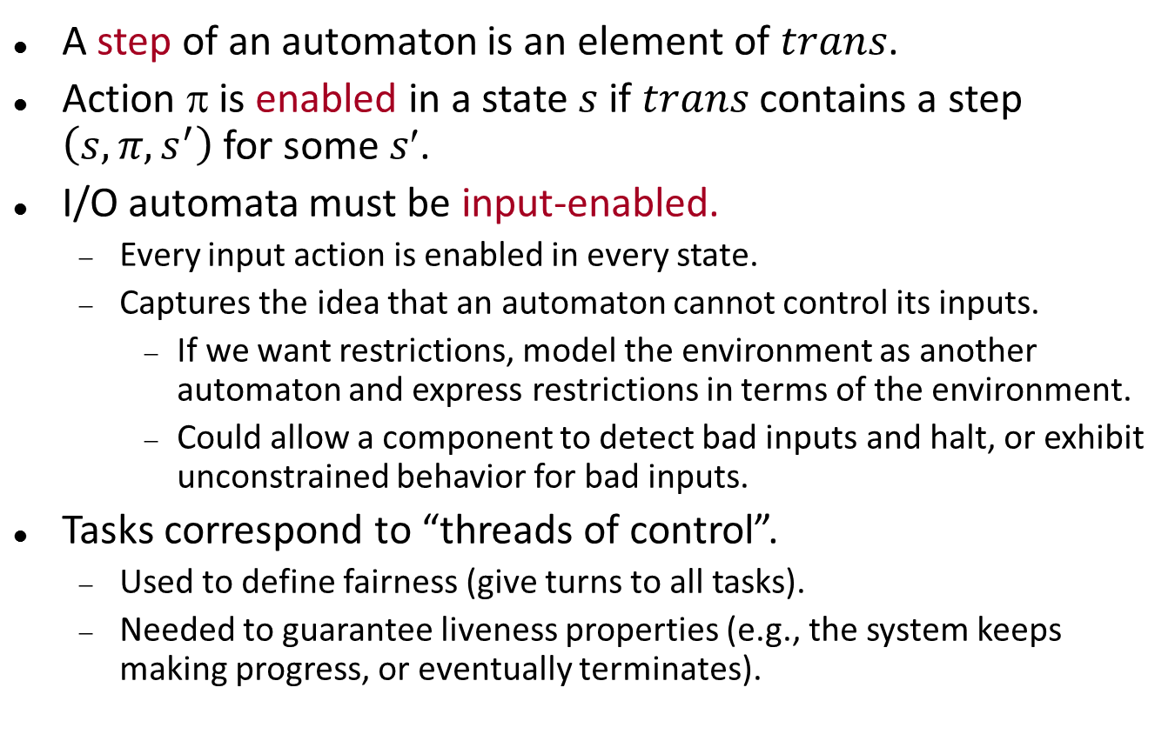
Remarks
A step of an automaton is an element of $trans$.
Action $$ is enabled in a state $s$ if $trans$ contains a step $\left(s,π,s^{′}\right)$for some $s$.
I/O automata must be input-enabled.
Every input action is enabled in every state.
Captures the idea that an automaton cannot control its inputs.
If we want restrictions, model the environment as another automaton and express restrictions in terms of the environment.
Could allow a component to detect bad inputs and halt, or exhibit unconstrained behavior for bad inputs.
Tasks correspond to “threads of control”.
Used to define fairness (give turns to all tasks).
Needed to guarantee liveness properties (e.g., the system keeps making progress, or eventually terminates).

Slide 33
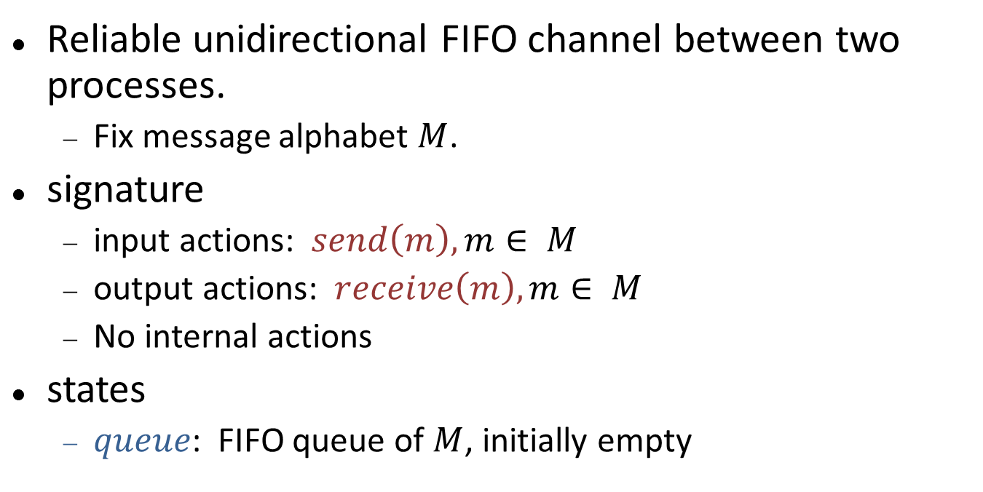
Example: Channel automaton
send(m)
receive(m)
C
Reliable unidirectional FIFO channel between two processes.
Fix message alphabet $M$.
signature
input actions: $send\left(m\right), m∈ M$
output actions: $receive\left(m\right), m∈ M$
No internal actions
states
$queue$: FIFO queue of $M$, initially empty

Slide 34
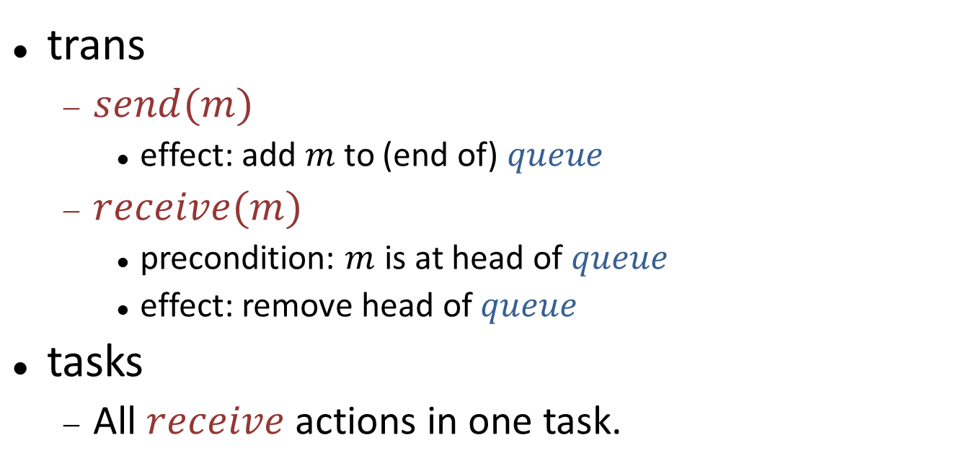
Channel automaton
send(m)
receive(m)
C
trans
$send(m)$
effect: add $m$ to (end of) $queue$
$receive(m)$
precondition: $m$ is at head of $queue$
effect: remove head of $queue$
tasks
All $receive$ actions in one task.
Notes:
Trans is described using “transition definitions”, which are little code fragments.
Each trans def describes a set of transitions, for designated actions (grouped by type of action).

Slide 35
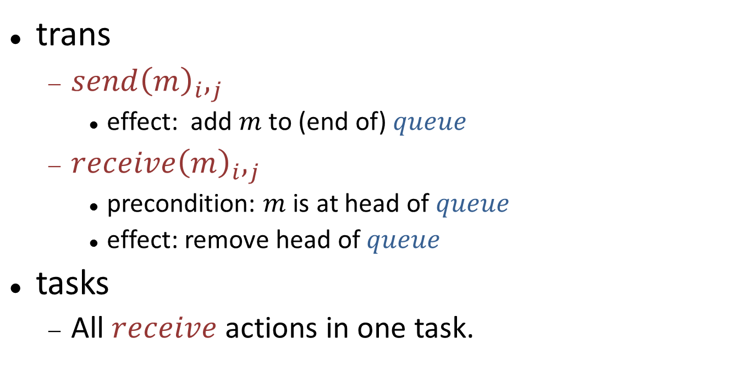
Channel automaton
p_{i}
send(m)_{i,j}
receive(m)_{i,j}
p_{j}
C_{i,j}
trans
$send{\left(m\right)}_{i},_{j}$
effect: add $m$ to (end of) $queue$
$receive{\left(m\right)}_{i},_{j}$
precondition: $m$is at head of $queue$
effect: remove head of $queue$
tasks
All $receive$ actions in one task.
Notes:
Sometimes add subscripts to indicate particular endpoints.
Here, the channel is used to connect processes i and j.

Slide 36
A process
E.g., in a consensus protocol.
See book, p. 205, for code details.
Inputs arrive from the outside.
Process sends/receives values, collects vector of values, one for each process.
When vector is filled, outputs a decision obtained as a function of the vector.
Can get new inputs, change values, send and output repeatedly.
Tasks for:
Sending to each individual neighbor.
Outputting decisions.
init
decide
p_{i}
send
receive

Slide 37
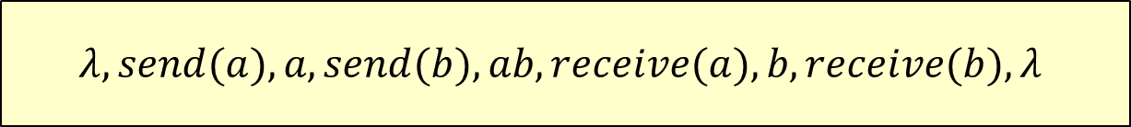
Executions
An I/O automaton executes as follows:
Start at some start state.
Repeatedly take step from current state to new state.
Formally, an execution is a finite or infinite sequence:
s₀ π₁ s₁ π₂ s₂ π₃ s₃ π₄ s₄ π₅ s₅ ... (if finite, ends in state)
s₀ is a start state
(s_{i}, π_{i+1}, s_{i+1}) is a step (i.e., in trans)
$$λ, send(a), a, send(b), ab, receive(a), b, receive(b), λ$$
Notes:
Example: Channel execution.
Lambda is just the empty sequence.
Any prefix of an execution is also an execution---no fairness requirement. So in example, could stop, say, after the b.

Slide 38
Execution fragments
An I/O automaton executes as follows:
Start at some start state.
Repeatedly take step from current state to new state.
Formally, an execution is a sequence:
s₀ π₁ s₁ π₂ s₂ π₃ s₃ π₄ s₄ π₅ s₅ ...
s₀ is a start state
(s_{i}, π_{i+1}, s_{i+1}) is a step.
execution fragment

Slide 39
Invariants and reachable states
A state is reachable if it appears in some execution.
Equivalently, at the end of some finite execution.
An invariant is a predicate that is true for every reachable state.
Most important tool for proving properties of concurrent/distributed algorithms.
Typically proved by induction on length of execution.
Notes:
Induction on length of execution, but now things are different from before, since only one transition, at one location, happens in each inductive step.
Before we had rounds, which meant that many things happened in one inductive step.

Slide 40
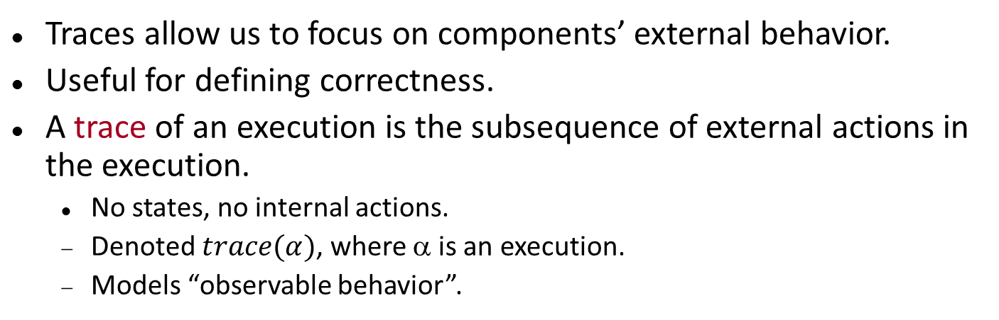
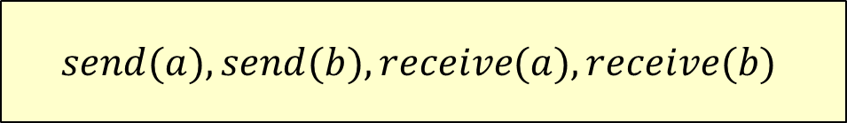
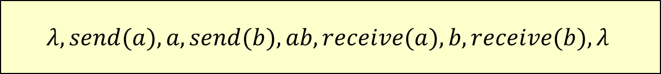
Traces
Traces allow us to focus on components’ external behavior.
Useful for defining correctness.
A trace of an execution is the subsequence of external actions in the execution.
No states, no internal actions.
Denoted $trace(α)$, where α is an execution.
Models “observable behavior”.
$$λ, send(a), a, send(b), ab, receive(a), b, receive(b),λ$$
$$send(a), send(b), receive(a), receive(b)$$

Slide 41
Operations on I/O Automata

Slide 42
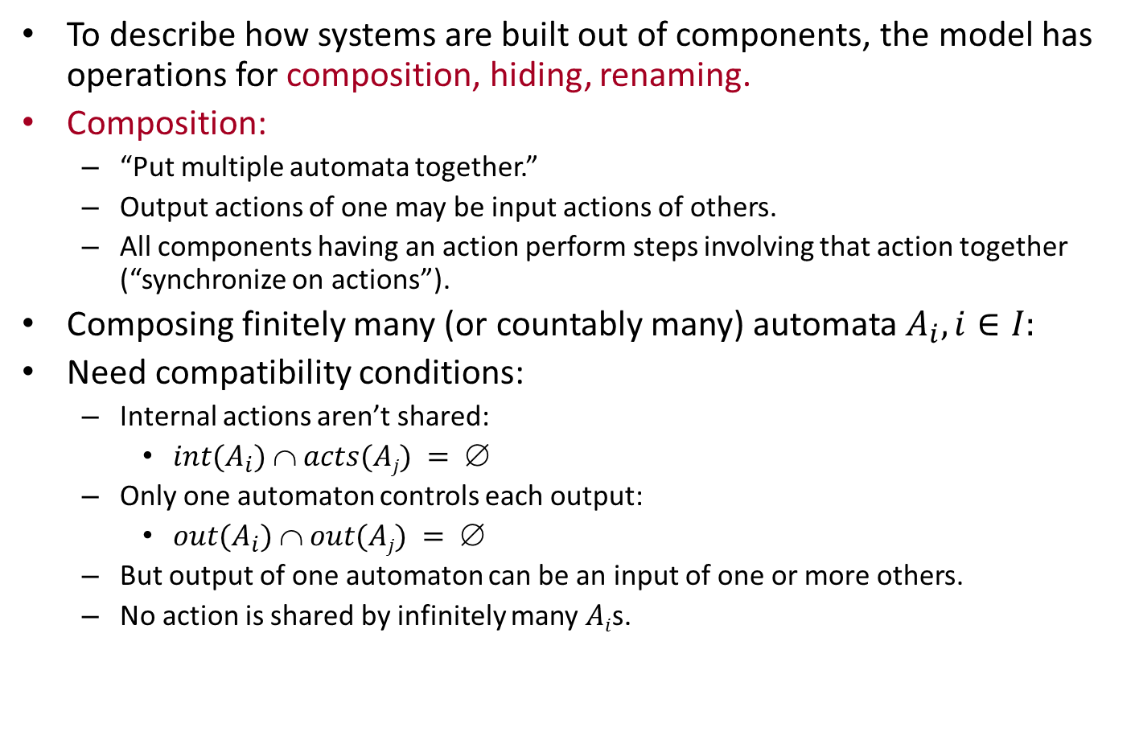
Operations on I/O automata
To describe how systems are built out of components, the model has operations for composition, hiding, renaming.
Composition:
“Put multiple automata together.”
Output actions of one may be input actions of others.
All components having an action perform steps involving that action together (“synchronize on actions”).
Composing finitely many (or countably many) automata $A_{i}, i∈I:$
Need compatibility conditions:
Internal actions aren’t shared:
$int(A_{i})  acts(Aj) = $
Only one automaton controls each output:
$out(A_{i})  out(Aj) = $
But output of one automaton can be an input of one or more others.
No action is shared by infinitely many $Ai$s.
Notes:
Why might we want to compose infinitely many automata?
Automata can be used to model systems in which some components are created dynamically, e.g., object-oriented programs. A nice way to model the dynamicalloy-created components is to pretend that they were there all along but just not awakened yet. They could have “wakeup” input actions.
The restriction that no action is shared by infinitely many automata is used for some simple pasting results. We will want to drop this later when modeling infinite compositions of services in the presence of failures (fail inputs may affect infinitely many components) The composition still makes sense. We have to make sure that we aren’t using the pasting result that depends on this. Or make a special argument that pasting still works because no fail event will be preceded by infinitely many events overall in the executions being pasted.

Slide 43
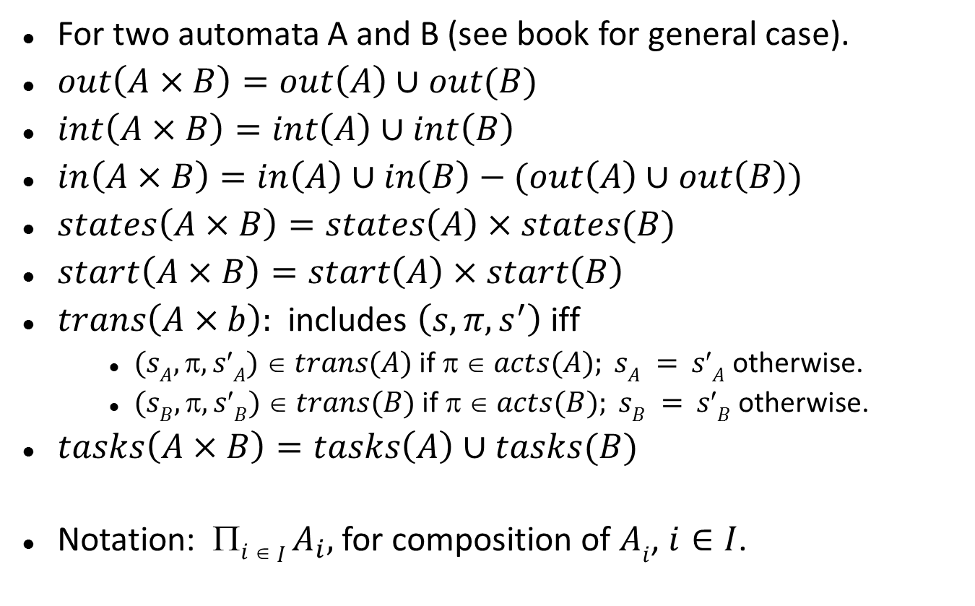
Composition of compatible automata
For two automata A and B (see book for general case).
$out\left(A×B\right)=out\left(A\right)∪out(B)$
$int\left(A×B\right)=int\left(A\right)∪int\left(B\right)$
$in\left(A×B\right)=in\left(A\right)∪in\left(B\right)−(out\left(A\right)∪out\left(B\right))$
$states\left(A×B\right)=states\left(A\right)×states(B)$
$start\left(A×B\right)=start\left(A\right)×start\left(B\right)$
$trans\left(A×b\right):$includes $\left(s,π,s^{′}\right)$ iff
$(sA, , sA)  trans(A)$if $  acts(A); sA = sA$otherwise.
$(sB, , sB)  trans(B)$if $  acts(B); sB = sB$otherwise.
$tasks\left(A×B\right)=tasks\left(A\right)∪tasks(B)$
Notation: $i  I A_{i},$for composition of $Ai$, $i∈I$.
Notes:
Discuss the action classification.
Tasks: Maintains all the threads of the components as separate threads in the composition.
This will be important when we consider fairness.
This all extends to arbitrary finite or countably infinite compositions.
Here, the index set I must be countable.

Slide 44
Composition of channels and consensus processes
p₁
send(m)_{1,2}
C_{1,2}
receive(m)_{1,2}
p₂
init(v)₁
decide(v)₁
C_{2,1}
receive(m)_{2,1}
send(m)_{2,1}
Notes:
The composition is a single IOA representing the entire consensus algorithm.
Go over the components: global states, start states, action classification, transitions, tasks.
Also describe the executions (but without the fairness).
Inputs arrive, exchange, output results.

Slide 45
Composition: Basic results
Projection
Execution of composition “looks good” to each component.
Pasting
If execution “looks good” to each component, it is good overall.
Substitutivity
Can replace a component with one that implements it.

Slide 46
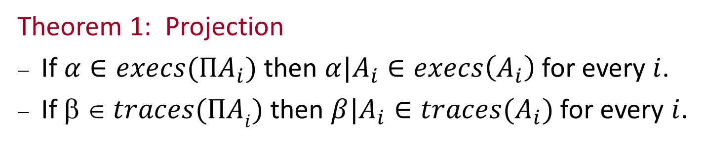
Composition: Basic results
Theorem 1: Projection
If$α∈execs(ΠA_{i})$ then $α|A_{i}∈execs\left(A_{i}\right)$ for every $i$.
If $  traces(ΠAi)$ then $β|A_{i}∈traces(A_{i})$ for every $i$.
Notes:
The projection for alpha involves deleting actions that don’t belong to Ai, and the following states, and then projecting the remaining states on the Ai component.

Slide 47
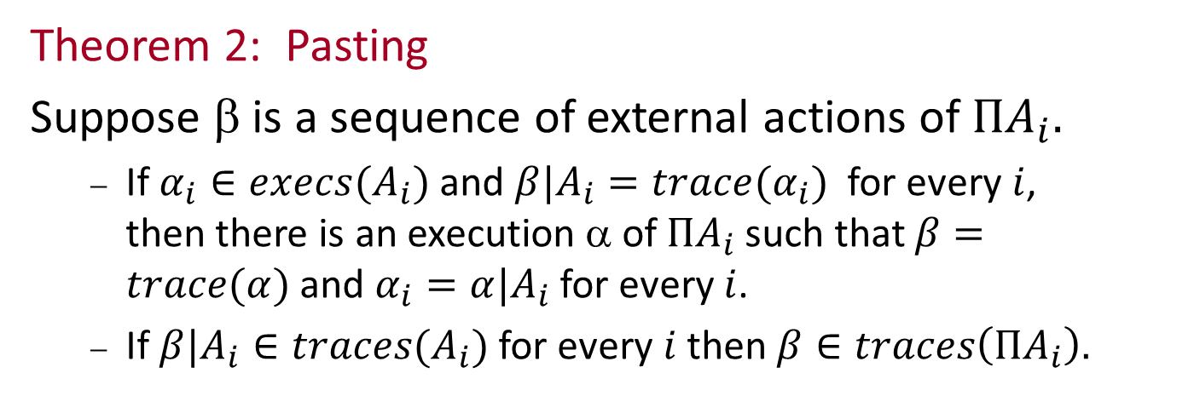
Composition: Basic results
Theorem 2: Pasting
Suppose $$ is a sequence of external actions of $ΠA_{i}.$
If $α_{i}∈execs(A_{i})$ and $β|A_{i}=trace(α_{i})$ for every $i$, then there is an execution α of $ΠA_{i}$such that $β=trace(α)$and $α_{i}=α|A_{i}$for every $i$.
If $β|A_{i}∈traces(A_{i})$for every $i$ then $β∈traces\left(ΠA_{i}\right).$

Slide 48
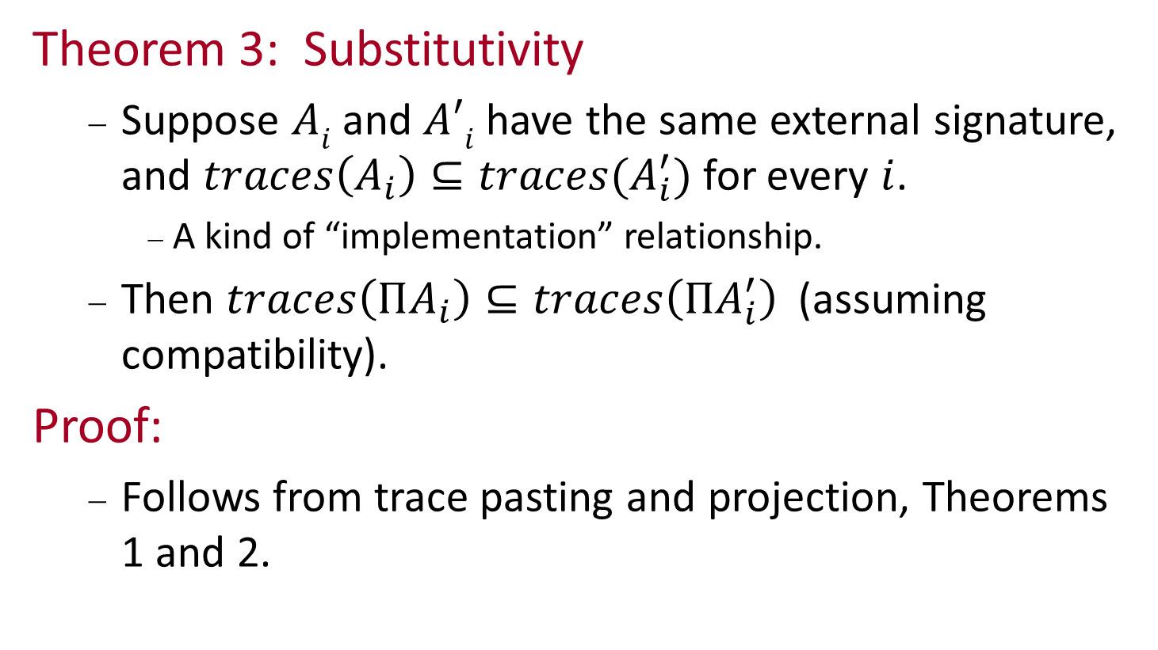
Composition: Basic results
Theorem 3: Substitutivity
Suppose $Ai$and $A′i$have the same external signature, and $traces\left(A_{i}\right)⊆traces(A_{i}^{′})$for every $i$.
A kind of “implementation” relationship.
Then $traces\left(ΠA_{i}\right)⊆traces\left(ΠA_{i}^{′}\right)$(assuming compatibility).
Proof:
Follows from trace pasting and projection, Theorems 1 and 2.

Slide 49
Other operations on I/O automata
Hiding
Reclassify some output actions as internal.
Hides internal communication among components of a system.
Renaming
Change names of some actions.
Action names are important for specifying component interactions.
E.g., define a “generic” automaton, then rename actions to define many instances to use in a system.
As we did with channel automata.

Slide 50
Fairness

Slide 51
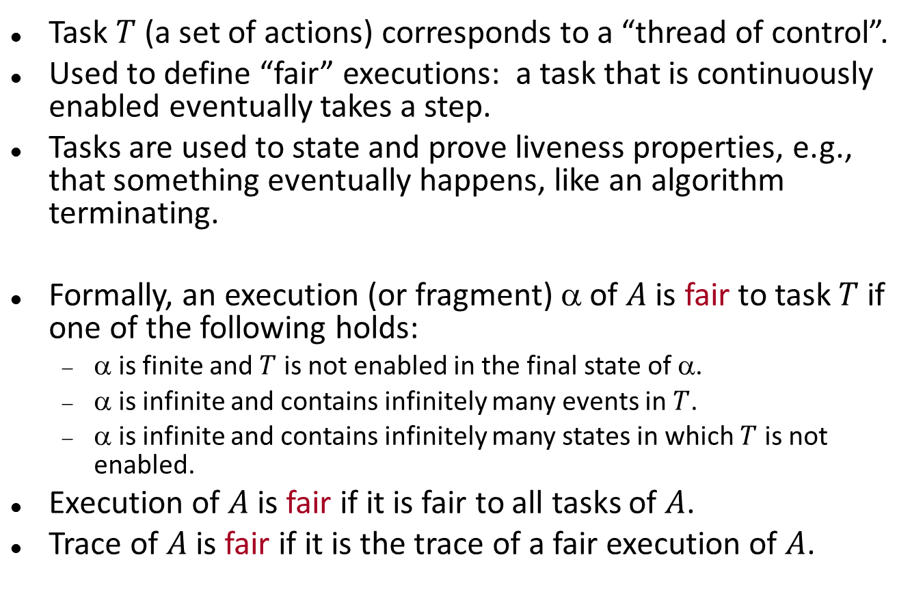
Fairness
Task $T$(a set of actions) corresponds to a “thread of control”.
Used to define “fair” executions: a task that is continuously enabled eventually takes a step.
Tasks are used to state and prove liveness properties, e.g., that something eventually happens, like an algorithm terminating.
Formally, an execution (or fragment) α of $A$ is fair to task $T$ if one of the following holds:
α is finite and $T$ is not enabled in the final state of α.
α is infinite and contains infinitely many events in $T$.
α is infinite and contains infinitely many states in which $T$ is not enabled.
Execution of $A$ is fair if it is fair to all tasks of $A$.
Trace of $A$ is fair if it is the trace of a fair execution of $A$.

Slide 52
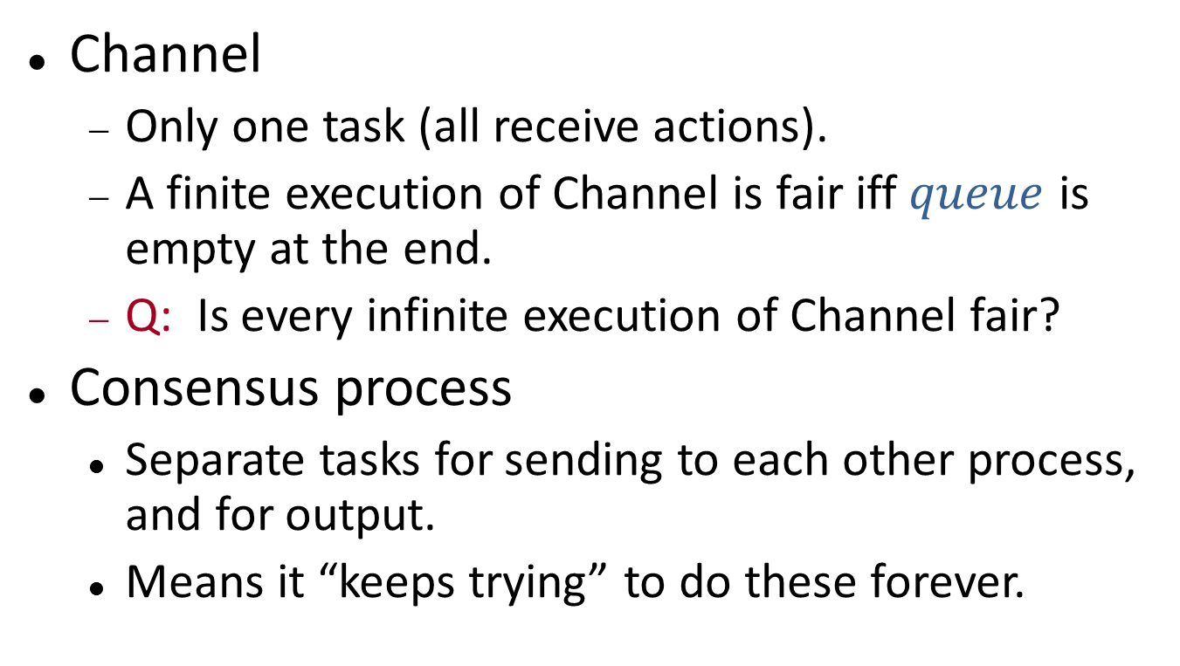
Example
Channel
Only one task (all receive actions).
A finite execution of Channel is fair iff $queue$ is empty at the end.
Q: Is every infinite execution of Channel fair?
Consensus process
Separate tasks for sending to each other process, and for output.
Means it “keeps trying” to do these forever.
Notes:
Not every infinite execution of Channel is fair---we can have infinitely many sends and finitely many receives.
Any infinite execution with infinitely many receives is fair. Those are the only fair ones.

Slide 53
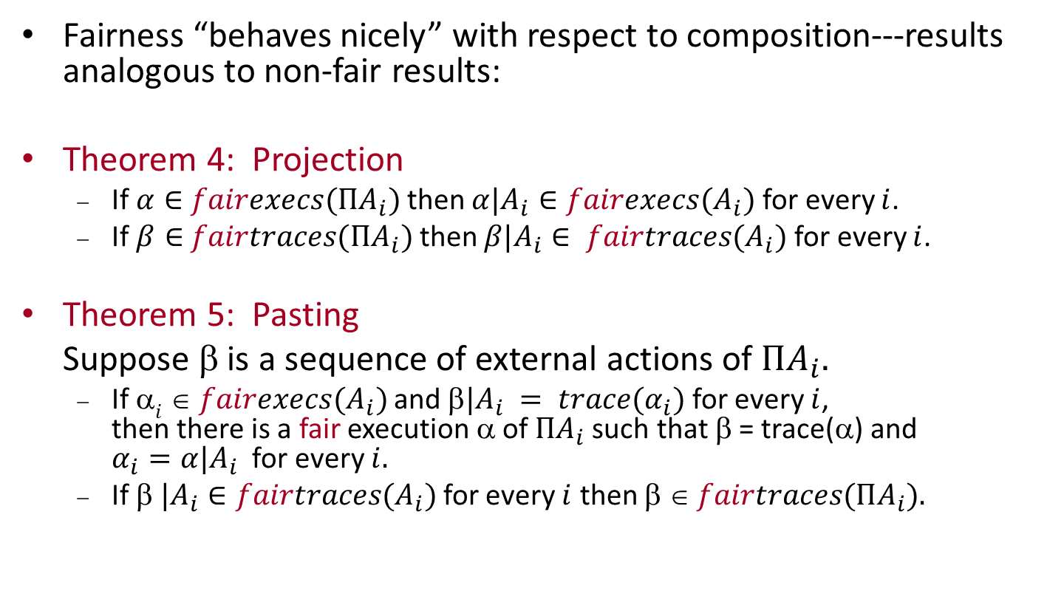
Fairness and composition
Fairness “behaves nicely” with respect to composition---results analogous to non-fair results:
Theorem 4: Projection
If $α∈$ $fairexecs(ΠA_{i})$then $α|A_{i}∈fairexecs(A_{i})$for every $i$.
If $β∈$ $fairtraces(ΠA_{i})$then $β|A_{i}∈ fairtraces(A_{i})$for every $i$.
Theorem 5: Pasting
Suppose β is a sequence of external actions of $ΠA_{i}.$
If $i  fairexecs(A_{i})$and $|A_{i} = trace(α_{i})$for every $i$, then there is a fair execution α of $ΠA_{i}$such that β = trace(α) and $α_{i}=α|A_{i}$ for every $i.$
If $ |A_{i}∈fairtraces(A_{i})$for every $i$ then $  fairtraces(ΠA_{i}).$

Slide 54

Fairness and composition
Theorem 6: Substitutivity
Suppose $Ai$ and $Ai$have the same external signature, and $fairtraces(A_{i})  fairtraces(A_{i}^{′})$for every $i$.
Another kind of “implementation” relationship.
Then $fairtraces(ΠA_{i})  fairtraces(ΠA_{i}^{′}).$

Slide 55
Composition of channels and consensus processes
p₁
send(m)_{1,2}
C_{1,2}
receive(m)_{1,2}
p₂
init(v)₁
decide(v)₁
C_{2,1}
receive(m)_{2,1}
send(m)_{2,1}
In fair executions:
After init, keep sending latest val forever.
All messages that are sent get delivered.
Once the vector is full, keep outputting the latest decision.
Notes:
The composition is a single IOA representing thte entire consensus algorithm.

Slide 56
Properties and Proof Methods
Compositional reasoning
Invariants
Trace properties
Simulation relations

Slide 57
Compositional reasoning
Use Theorems 1-6 to infer properties of a system from properties of its components.
And vice versa.

Slide 58
Invariants
A state is reachable if it appears in some execution (or, at the end of some finite execution).
An invariant is a predicate that is true for every reachable state.
Most important tool for proving properties of concurrent and distributed algorithms.
Proving invariants:
Typically, by induction on length of execution.
Often prove batches of inter-dependent invariants together.
Step granularity is finer than round granularity, so proofs are more complicated and detailed than those for synchronous algorithms.

Slide 59
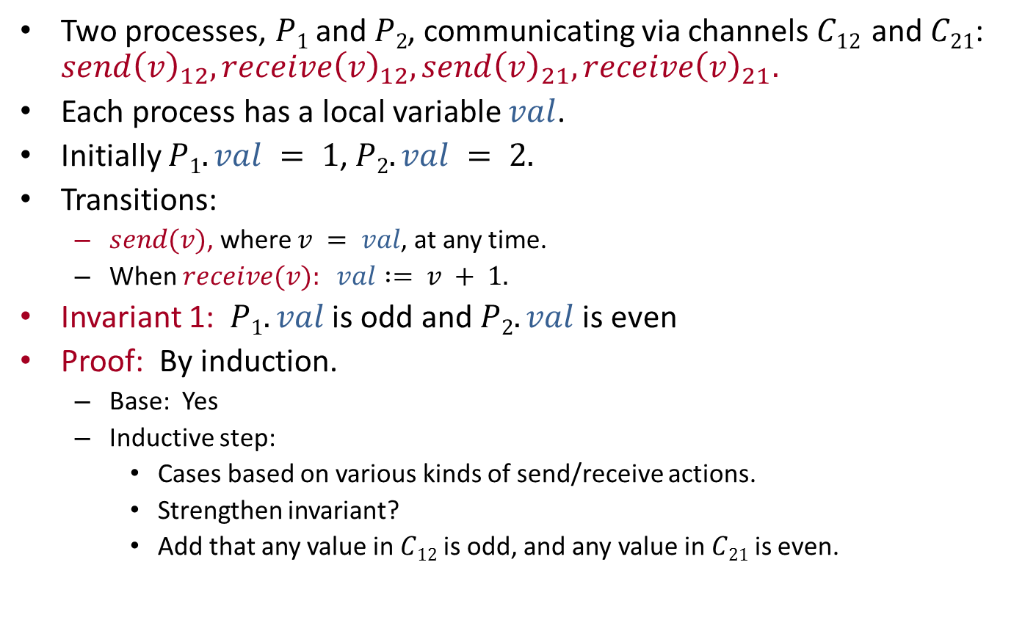
Example: Incrementing
Two processes, $P1$ and $P2$, communicating via channels $C12$ and $C21$: $send{\left(v\right)}_{12}, receive{\left(v\right)}_{12}, send{\left(v\right)}_{21}, receive{\left(v\right)}_{21}.$
Each process has a local variable $val$.
Initially $P1.val = 1$, $P2.val = 2.$
Transitions:
$send(v)$, where $v = val$, at any time.
When $receive(v): val := v + 1.$
Invariant 1: $P1.val$is odd and $P2.val$ is even
Proof: By induction.
Base: Yes
Inductive step:
Cases based on various kinds of send/receive actions.
Strengthen invariant?
Add that any value in $C12$ is odd, and any value in $C21$ is even.
Notes:
Go over cases in proof of Invariant 1:
Send preserves channel parity condition (based on process parity condition), without affecting process parity condition.
Receive preserves process parity condition (based on channel parity condition), without affecting channel parity condition.

Slide 60
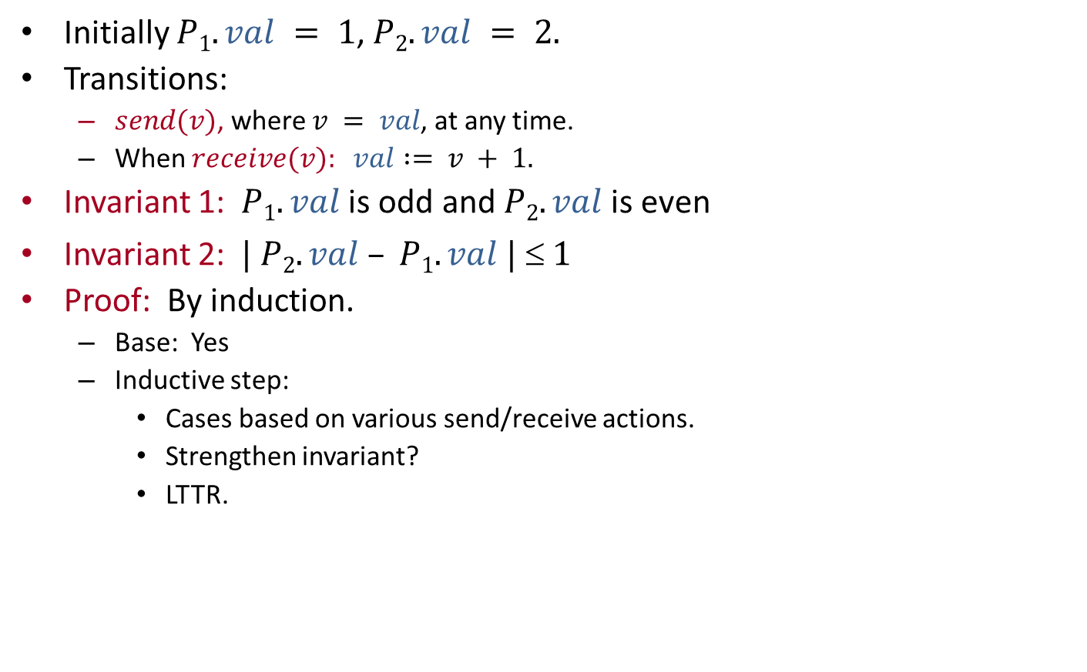
Example: Incrementing
Initially $P1.val = 1$, $P2.val = 2.$
Transitions:
$send(v)$, where $v = val$, at any time.
When $receive(v): val := v + 1.$
Invariant 1: $P1.val$is odd and $P2.val$ is even
Invariant 2: $| P2.val – P1.val |  1$
Proof: By induction.
Base: Yes
Inductive step:
Cases based on various send/receive actions.
Strengthen invariant?
LTTR.
Notes:
Invariant 2 can be strengthened, e.g.:
Either p1.val = p2.val + 1 or vice versa.
In the former case, C12 contains just p2.val – 1 = p1.val -2 and p2.val+1 = p1.val, in order, and C21 contains just p2.val.
In the latter case, C21 contains just p1.val – 1 = p2.val -2 and p1.val+1 = p2.val, in order, and C12 contains just p1.val.
Cases: send by smaller, send by larger, receive by smaller, receive by larger.

Slide 61
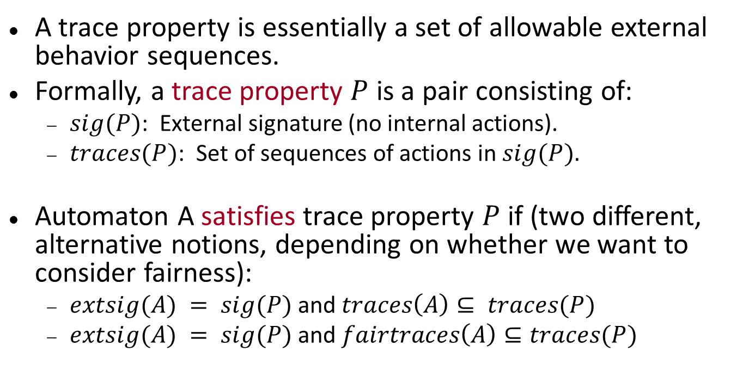
Trace properties
A trace property is essentially a set of allowable external behavior sequences.
Formally, a trace property $P$ is a pair consisting of:
$sig(P)$: External signature (no internal actions).
$traces(P)$: Set of sequences of actions in $sig(P).$
Automaton A satisfies trace property $P$ if (two different, alternative notions, depending on whether we want to consider fairness):
$extsig(A) = sig(P)$and $traces\left(A\right)⊆ traces(P)$
$extsig(A) = sig(P)$and $fairtraces\left(A\right)⊆traces(P)$

Slide 62

Safety and liveness
Safety property: “Bad” thing doesn't happen:
Nonempty (null trace is always safe).
Prefix-closed: Every prefix of a safe trace is safe.
Limit-closed: Limit of sequence of safe traces is safe.
Liveness property: “Good” thing happens eventually:
Every finite sequence over $acts(P)$can be extended to a sequence in $traces(P)$.
“It's never too late.”
Define safety/liveness for executions similarly.

Slide 63
Automata as specifications
Every I/O automaton specifies a trace property $(extsig(A), traces(A)).$
So we can use an automaton as a problem specification.
Automaton $A$ “implements” automaton $B$ if
$extsig(A) = extsig(B)$
$traces\left(A\right)⊆traces(B)$
Notes:
“Implements” can mean different things, depending on whether we consider fairness. Here, we don’t.

Slide 64
Hierarchical proofs
Important strategy for proving correctness of complex asynchronous distributed algorithms.
Define a series of automata, each implementing the previous one (“successive refinement”).
Highest-level automaton model captures the “real” problem specification.
Next level is a high-level algorithm description.
Successive levels represent more and more detailed versions of the algorithm.
Lowest level is the full algorithm description.
Abstract spec
High-level
algorithm
description
Detailed
Algorithm
description
Notes:
“Implements” can mean different things, depending on whether we consider fairness. Here, we don’t.

Slide 65
Hierarchical proofs
For example:
High levels centralized, lower levels distributed.
High levels inefficient but simple, lower levels optimized and more complex.
High levels with large granularity steps, lower levels with finer granularity steps.
In all these cases, lower levels are harder to understand and reason about.
So instead of reasoning about them directly, relate them to higher-level descriptions.
Method similar to what we saw for synchronous algorithms.
Abstract spec
High-level
algorithm
description
Detailed
Algorithm
description

Slide 66
Hierarchical proofs
Recall, for synchronous algorithms:
Optimized algorithm runs side-by-side with unoptimized version, and “invariant” proved to relate the states of the two algorithms.
Prove using induction.
For asynchronous systems, it’s harder:
Asynchronous model has more nondeterminism (in choice of new state, in order of steps).
So, it’s harder to determine which executions to compare.
One-way implementation relationship is enough:
For each execution of the lower-level algorithm, there is a corresponding execution of the higher-level algorithm.
“Everything the algorithm does is allowed by the spec.”
Don’t need the other direction: it doesn’t matter if the algorithm does everything that is allowed.
Abstract spec
High-level
algorithm
description
Detailed
Algorithm
description
Notes:
Also similar to abstraction function methods for data types, in object-oriented programming.

Slide 67

Simulation relations
Most common method of proving that one automaton implements another.
Assume $A$ and $B$ have the same $extsig$, and $R$ is a binary relation from $states(A)$ to $states(B)$.
Then $R$ is a simulation relation from $A$ to $B$ provided:
$s_{A}∈start\left(A\right)$ implies that there exists $s_{B}∈start\left(B\right)$such that $sA R sB.$
If $sA$, $sB$ are reachable states of $A$ and $B$ respectively, $sA R sB$ and $(sA, , sA)$is a step of $A$, then there is an execution fragment β of B, starting with $sB$ and ending with $sB$such that $sA R sB$and $trace\left(β\right)=trace\left(π\right).$

Slide 68


Simulation relations
s_{B}
$$β$$
s′_{B}
R
R
$$π$$
s_{A}
s′_{A}
$R$ is a simulation relation from $A$ to $B$ provided:
$s_{A}∈start\left(A\right)$ implies that there exists $s_{B}∈start\left(B\right)$such that $sA R sB.$
If $sA$, $sB$ are reachable states of $A$ and $B$, $sA R sB$ and $(sA, , sA)$is a step, then there is an execution fragment β starting with $sB$ and ending with $sB$such that $sA R sB$and$trace\left(β\right)=trace\left(π\right).$
Notes:
Beta can consist of 0, 1, or more steps, as long as it looks the same externally.
If pi is an external action, then beta must consist of pi and 0 or more internal actions.
If pi is an internal action, then beta must consist of just 0 or more internal actions.

Slide 69

Simulation relations
Theorem: If there is a simulation relation from $A$ to $B$ then $traces\left(A\right)⊆traces\left(B\right).$
All traces of $A,$ not just finite traces.
Proof: Fix a trace of $A$, arising from a (possibly infinite) execution of $A$.
Create a corresponding execution of $B$, using an iterative construction.
$$π_{1}$$
$$π_{2}$$
$$π_{3}$$
$$π_{4}$$
$$π_{5}$$
s_{0,A}
s_{1,A}
s_{2,A}
s_{3,A}
s_{4,A}
s_{5,A}

Slide 70
Simulation relations
Theorem: If there is a simulation relation from $A$ to $B$ then $traces\left(A\right)⊆traces\left(B\right).$
s_{0,B}
R
$$π_{1}$$
$$π_{2}$$
$$π_{3}$$
$$π_{4}$$
$$π_{5}$$
s_{0,A}
s_{1,A}
s_{2,A}
s_{3,A}
s_{4,A}
s_{5,A}
Notes:
Use the start condition to get a corresponding start state of B.

Slide 71
Simulation relations
Theorem: If there is a simulation relation from $A$ to $B$ then $traces\left(A\right)⊆traces\left(B\right).$
$$β_{1}$$
s_{0,B}
s_{1,B}
R
R
$$π_{1}$$
$$π_{2}$$
$$π_{3}$$
$$π_{4}$$
$$π_{5}$$
s_{0,A}
s_{1,A}
s_{2,A}
s_{3,A}
s_{4,A}
s_{5,A}
Notes:
Then use the step condition to get the first portion of the execution of B, ending in a state that corresponds with s_1,A.

Slide 72

Simulation relations
Theorem: If there is a simulation relation from $A$ to $B$ then $traces\left(A\right)⊆traces\left(B\right).$
$$β_{1}$$
$$β_{2}$$
$$β_{3}$$
$$β_{4}$$
$$β_{5}$$
s_{0,B}
s_{1,B}
s_{2,B}
s_{3,B}
s_{4,B}
s_{5,B}
R
R
R
R
R
R
$$π_{1}$$
$$π_{2}$$
$$π_{3}$$
$$π_{4}$$
$$π_{5}$$
s_{0,A}
s_{1,A}
s_{2,A}
s_{3,A}
s_{4,A}
s_{5,A}
Notes:
And continue. It’s easy to see that we get the same trace, as needed.
This construction works for finite or infinite executions of A.
It says nothing about fairness.

Slide 73
Example: Channels
Show two channels implement one.
Rename some actions.
Let $D=hide_{\left\{pass\left(m\right)\right\}}$ $A×B.$
Show that $traces\left(D\right)⊆traces(C).$
send(m)
receive(m)
C
send(m)
pass(m)
receive(m)
B
A

Slide 74
Recall: Channel automaton
send(m)
receive(m)
C
Reliable unidirectional FIFO channel.
$sig$
Input actions: $send\left(m\right), m∈M$
output actions: $receive\left(m\right), m∈M$
No internal actions
$states$
$queue$: FIFO queue of $M$, initially empty

Slide 75

Channel automaton
send(m)
receive(m)
C
$trans$
$send(m)$
effect: add $m$ to $queue$
$receive(m)$
precondition: $m = head(queue)$
effect: remove head of $queue$
$tasks$
All $receive$ actions in one task
Notes:
But the tasks don’t matter here.

Slide 76
Composing two channel automata
send(m)
pass(m)
receive(m)
B
A
Output of $B$ is input of $A$
Rename $receive(m)$ of $B$ and $send(m)$of $A$ to $pass(m)$.
Claim $D=hide_{\left\{pass\left(m\right)\right\}} A×B$implements $C$.
Define relation $R$:
For $s∈states(D)$ and $u∈states(C)$, define $s R u$iff $u.queue$ is the concatenation of $s.A.queue$ and $s.B.queue.$
Proof that $R$ is a simulation relation:
Start condition: All queues are empty, so start states correspond.
Step condition: Define “step correspondence”:

Slide 77
Composing two channel automata
send(m)
pass(m)
receive(m)
B
A
s R u iff u.queue is concatenation of s.A.queue and s.B.queue
Step correspondence:
For each step $\left(s,π,s^{′}\right)∈trans(D)$ and $u$ such that $s R u$, define execution fragment β of $C$:
Starts with $u$, ends with $u$ such that $s R u.$
trace(β) = trace(π)
Here, actions in β depend only on π, and uniquely determine the states.
Same action if external, empty sequence if internal.

Slide 78
Composing two channel automata
send(m)
pass(m)
receive(m)
B
A
s R u iff u.queue is concatenation of s.A.queue and s.B.queue
Step correspondence:
π $=send(m)$in $D$ corresponds to $send(m)$in $C$
π $=receive(m)$ in $D$ corresponds to $receive(m)$ in $C$
π $=pass(m)$ in $D$corresponds to λ in $C$
Verify that this works:
Same external actions (yes).
Actions of $C$ are enabled.
Final states related by relation $R$.
Routine case analysis:

Slide 79

Showing $R$ is a simulation relation
s R u iff u.queue is concatenation of s.A.queue and s.B.queue
Case 1: π $=send(m)$
No enabling issues (input).
Must check that $s R u.$
Since $s R u$, $u.queue$ is the concatenation of $s.A.queue$ and $s.B.queue$.
Adding the same $m$ to the end of $u.queue$and $s.B.queue$ maintains the correspondence.
Case 2: π $= receive(m)$
Enabling: Check that $receive(m)$, for the same $m$, is also enabled in $u$.
We know that $m$ is first on $s.A.queue.$
Since $s R u$, $m$ is also first on $u.queue.$
So $receive(m)$is enabled in $u$.
$s R u$: Since $m$ is removed from both $s.A.queue$ and $u.queue.$

Slide 80
Showing R is a simulation relation
s R u iff u.queue is concatenation of s.A.queue and s.B.queue
Case 3: π $= pass(m)$
No enabling issues (since no high-level steps are involved).
Must check $s R u:$
Since $s R u$, $u.queue$ is the concatenation of $s.A.queue$ and $s.B.queue$.
The concatenation of the queues is unchanged as a result of this step, so also $u.queue$ is the concatenation of $s.A.queue$and $s.B.queue$.
u
R
R
s
s′
pass(m)
Notes:
And all this could be checked with a theorem-prover.

Slide 81
Next lecture
A bit more on safety and liveness properties.
Then, basic asynchronous network algorithms:
Leader election
Breadth-first search
Shortest paths
Spanning trees.
Reading:
Chapters 14 and 15

